Slide 1

Computer Networks
Internet Protocol, ICMP
S.V.Jansi Rani
Associate Professor / CSE

Slide 2
AGENDA
Internet Protocol
Datagram
Fragmentation
Options
Security
ICMP
Messages
Debugging Tool
Checksum

Slide 3



Slide 4
NETWORK-LAYER PROTOCOLS
The main protocol, IPv4 -is responsible for packetizing, forwarding, and delivery of a packet.
The ICMPv4 helps IPv4 to handle some errors that may occur in delivery.
The IGMP is used to help IPv4 in multicasting.
ARP is used in address mapping.

Slide 5
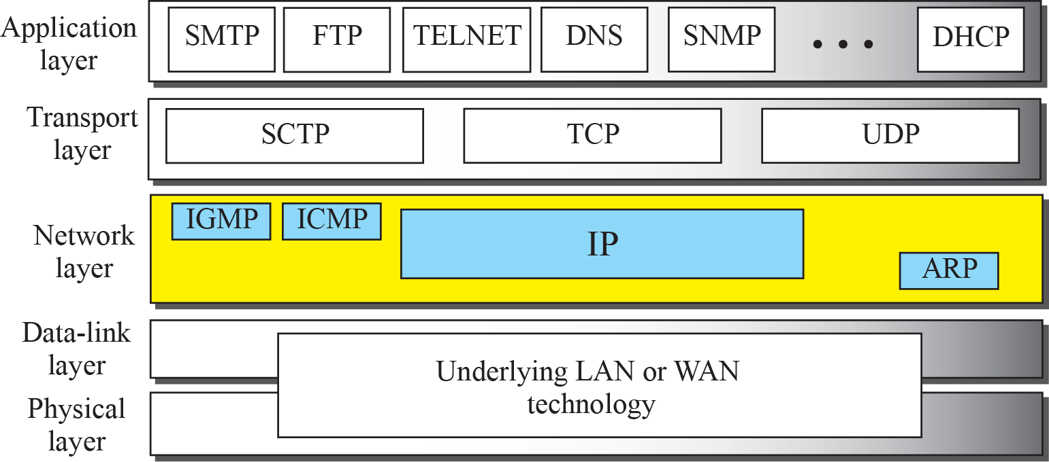
Position of IP and other network-layer protocols in
TCP/IP protocol suite

Slide 6
Datagram Format
Packets used by the IP are called datagrams - variable-length packet consisting of two parts:
Header - 20 to 60 bytes
Payload - data -information essential to routing and delivery.
It is customary in TCP/IP to show the header in 4-byte sections..

Slide 7
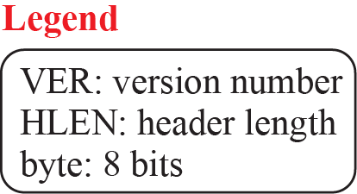
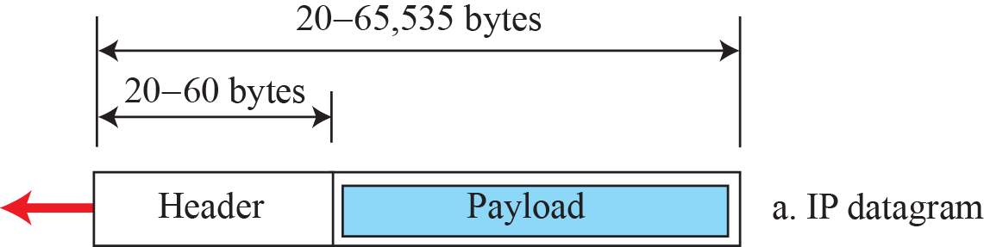

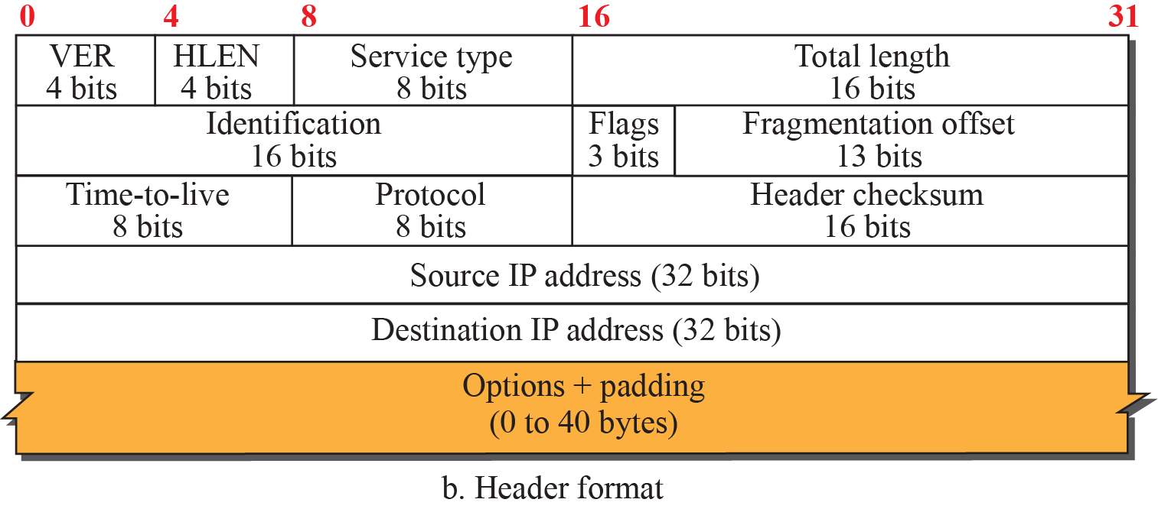
IP datagram

Slide 8
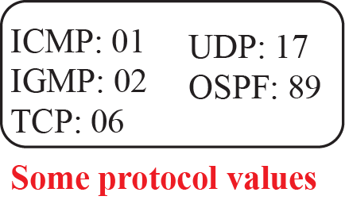
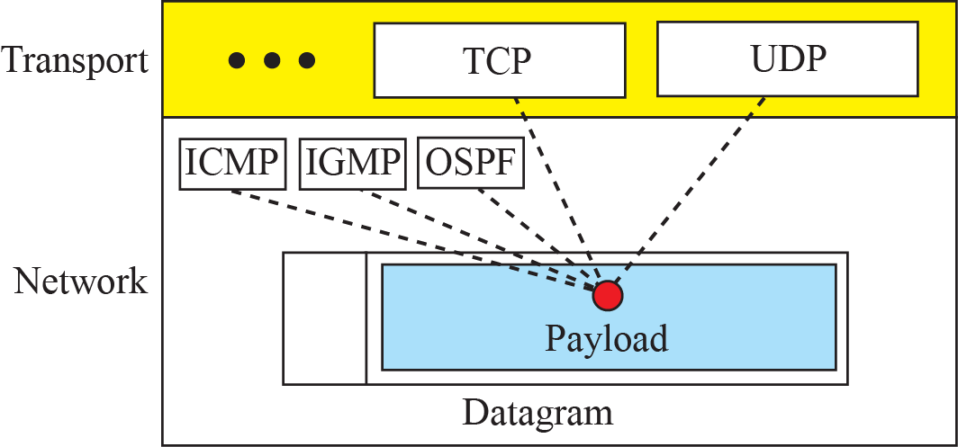
Multiplexing and demultiplexing using the value of
the protocol field

Slide 9
Example
An IPv4 packet has arrived with the first 8 bits as (01000010)₂ The receiver discards the packet. Why?.
Solution
There is an error in this packet. The 4 leftmost bits (0100)₂ show the version, which is correct. The next 4 bits (0010)₂ show an invalid header length (2 × 4 = 8). The minimum number of bytes in the header must be 20. The packet has been corrupted in transmission.

Slide 10
Example
In an IPv4 packet, the value of HLEN is (1000)₂. How many bytes of options are being carried by this packet?
Solution
The HLEN value is 8, which means the total number of bytes in the header is 8 × 4, or 32 bytes. The first 20 bytes are the base header, the next 12 bytes are the options.

Slide 11
Example
In an IPv4 packet, the value of HLEN is 5, and the value of the total length field is (0028)₁₆. How many bytes of data are being carried by this packet?
Solution
The HLEN value is 5, which means the total number of bytes in the header is 5 × 4, or 20 bytes (no options). The total length is (0028)₁₆ or 40 bytes, which means the packet is carrying 20 bytes of data (40 − 20).

Slide 12
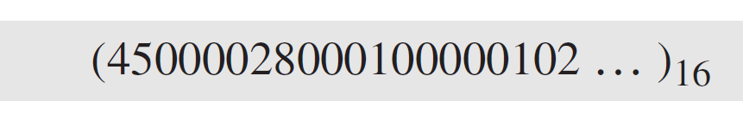
Example
An IPv4 packet has arrived with the first few hexadecimal digits as shown.
How many hops can this packet travel before being dropped? The data belong to what upper-layer protocol?
Solution
To find the time-to-live field, we skip 8 bytes (16 hexadecimal digits). The time-to-live field is the ninth byte, which is (01)₁₆. This means the packet can travel only one hop. The protocol field is the next byte (02)₁₆, which means that the upper-layer protocol is IGMP.

Slide 13
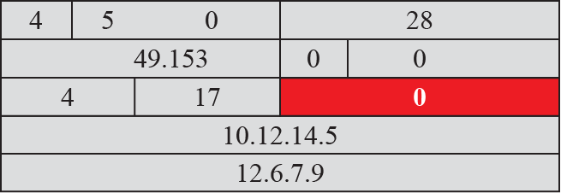

Slide 14
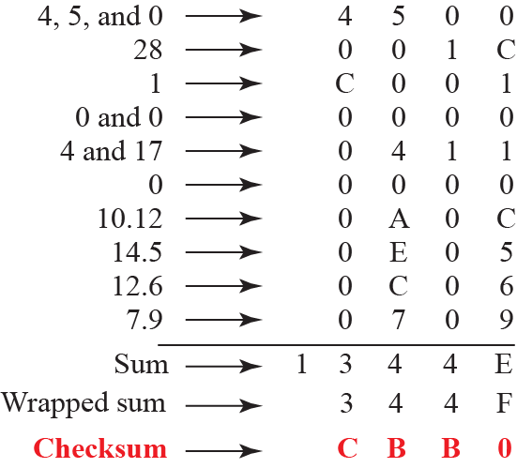
Checksum Calculation

Slide 15
Fragmentation
A datagram can travel through different networks.
Each router decapsulates the IP datagram from the frame it receives, processes it, and then encapsulates it in another frame.
The format and size of the received frame depend on the protocol used by the physical network through which the frame has just traveled.

Slide 16
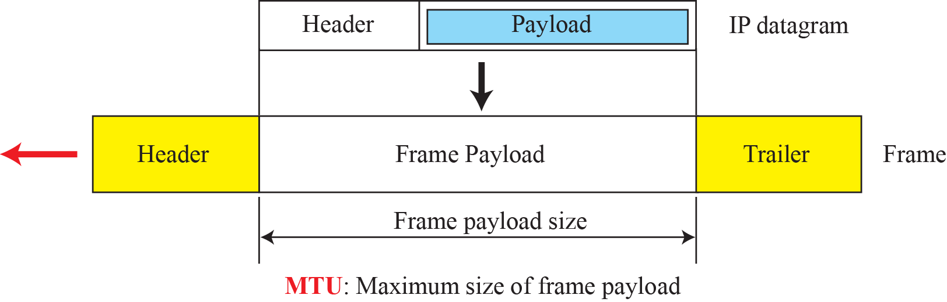
Maximum transfer unit (MTU)

Slide 17
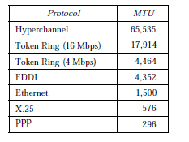

Slide 18
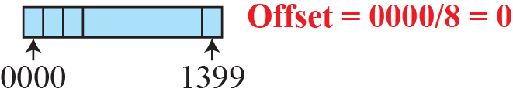
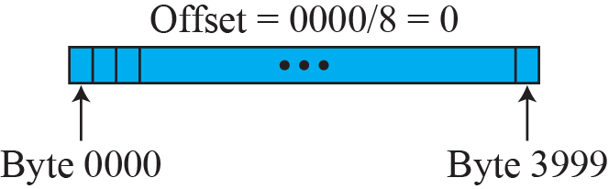
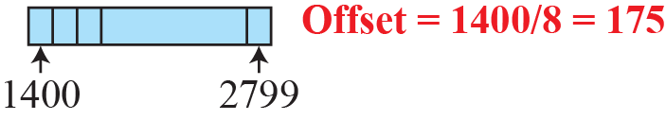
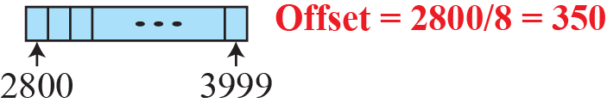
Fragmentation example

Slide 19
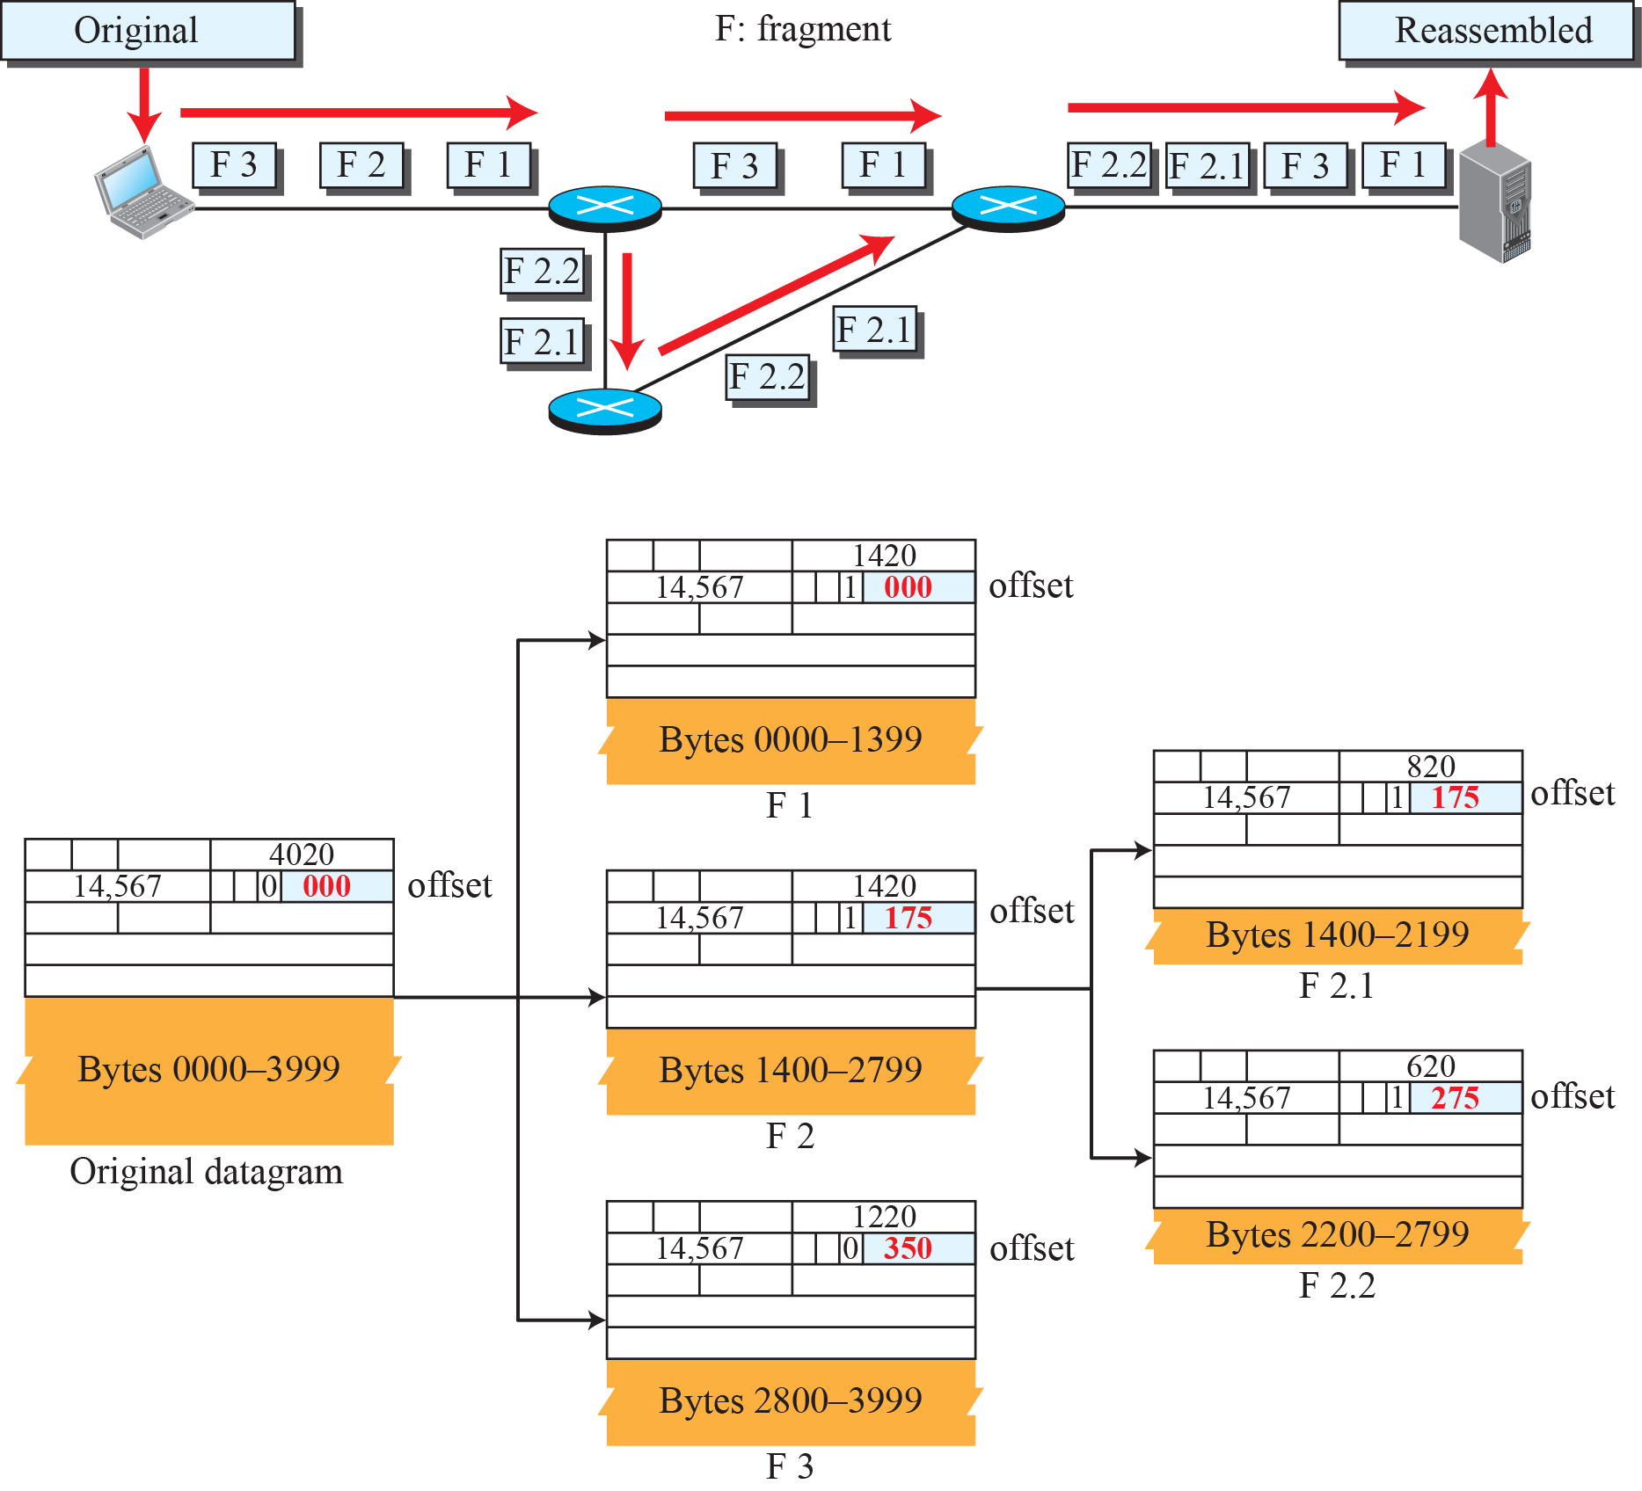

Slide 20
Example
A packet has arrived with an M bit value of 0. Is this the first fragment, the last fragment, or a middle fragment? Do we know if the packet was fragmented?
Solution
If the M bit is 0, it means that there are no more fragments; the fragment is the last one. However, we cannot say if the original packet was fragmented or not. A nonfragmented packet is considered the last fragment.

Slide 21
Example
A packet has arrived with an M bit value of 1. Is this the first fragment, the last fragment, or a middle fragment? Do we know if the packet was fragmented?
Solution
If the M bit is 1, it means that there is at least one more fragment. This fragment can be the first one or a middle one, but not the last one. We don’t know if it is the first one or a middle one; we need more information (the value of the fragmentation offset).

Slide 22
Example
A packet has arrived with an M bit value of 1 and a fragmentation offset value of 0. Is this the first fragment, the last fragment, or a middle fragment?
Solution
Because the M bit is 1, it is either the first fragment or a middle one. Because the offset value is 0, it is the first fragment.

Slide 23
Example
A packet has arrived in which the offset value is 100. What is the number of the first byte? Do we know the number of the last byte?
Solution
To find the number of the first byte, we multiply the offset value by 8. This means that the first byte number is 800. We cannot determine the number of the last byte unless we know the length of the data.

Slide 24
Example
A packet has arrived in which the offset value is 100, the value of HLEN is 5, and the value of the total length field is 100. What are the numbers of the first byte and the last byte?
Solution
The first byte number is 100 × 8 = 800. The total length is 100 bytes, and the header length is 20 bytes (5 × 4), which means that there are 80 bytes in this datagram. If the first byte number is 800, the last byte number must be 879.

Slide 25
Options
Fixed part -20, Variable part-40 bytes long
Single byte option – no operation (filler), end of option
Multiple byte option
Record route
Strict source route
Loose source route
Timestamp

Slide 26
Security of IPV4
Packet Sniffing – make a copy of IP packet –passive attack
Packet modification – change contents
IP Spoofing –masquerade as somebody
IPSec –connection oriented
Defining algorithms and keys
Packet encryption
Data integrity
Origin authentication

Slide 27
ICMPv4
The IPv4 has no error-reporting or error-correcting mechanism.
The IP protocol also lacks a mechanism for host and management queries.
The Internet Control Message Protocol version 4 (ICMPv4) has been designed to compensate for the above two deficiencies.

Slide 28
ICMP MESSAGES
ICMP messages are divided into two broad categories:
Error-reporting messages - router or a host problems
Query message - help a host or a network manager get specific information from a router or another host.
Eg: Nodes can discover their neighbors,
Host - learn about routers on their network,
Routers can help a node redirect its messages.

Slide 29
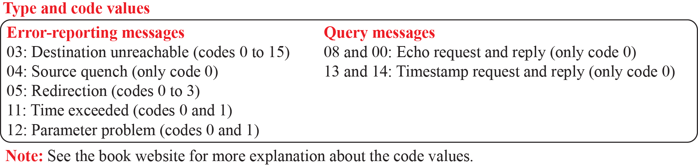
General format of ICMP messages

Slide 30
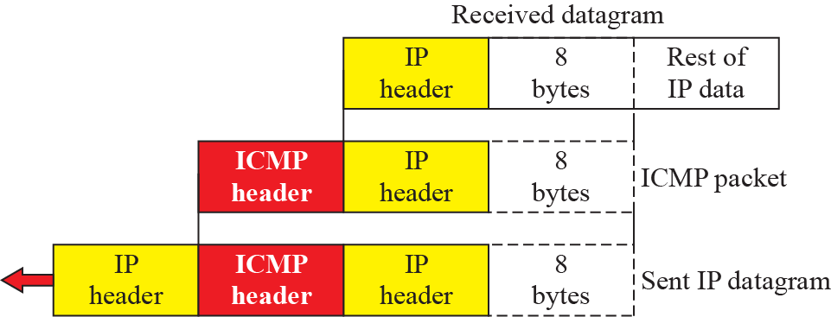
Contents of data field for the error messages

Slide 31
Debugging Tools
There are several tools that can be used in the Internet for debugging. We can determine the viability of a host or router. We can trace the route of a packet. We introduce two tools that use ICMP for debugging: ping and traceroute.

Slide 32
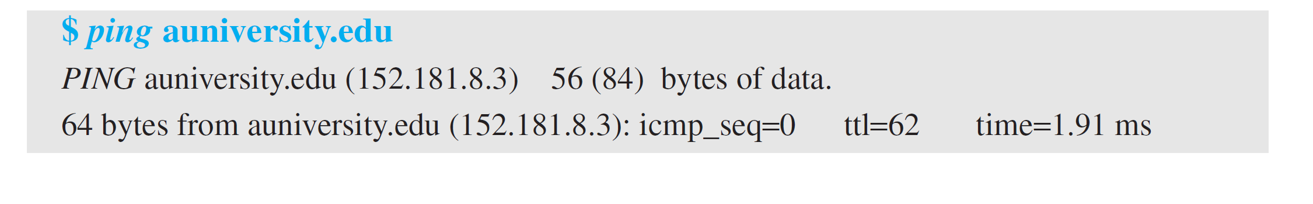
Example
The following shows how we send a ping message to the auniversity.edu site. We set the identifier field in the echo request and reply message and start the sequence number from 0; this number is incremented by one each time a new message is sent. Note that ping can calculate the round-trip time. It inserts the sending time in the data section of the message. When the packet arrives, it subtracts the arrival time from the departure time to get the round-trip time (rtt).

Slide 33
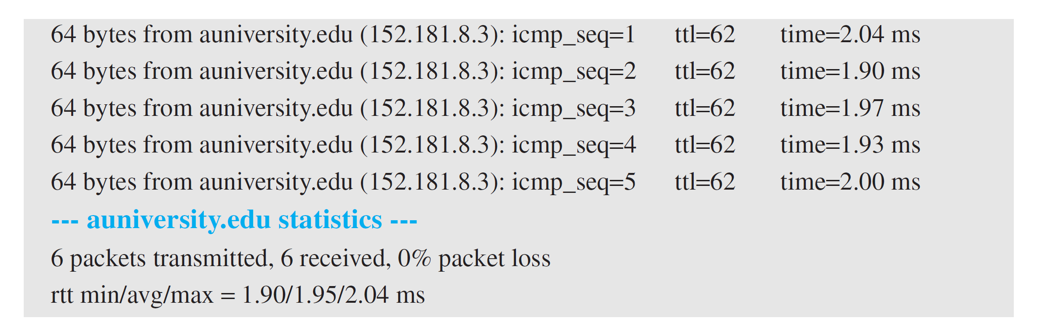
Example

Slide 34
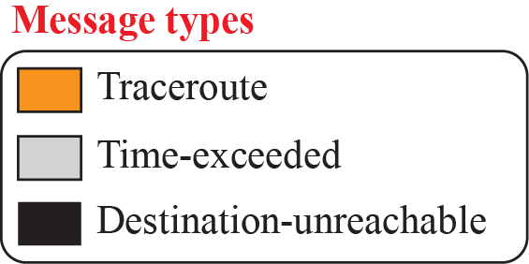




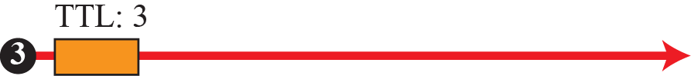



Example of traceroute program

Slide 35
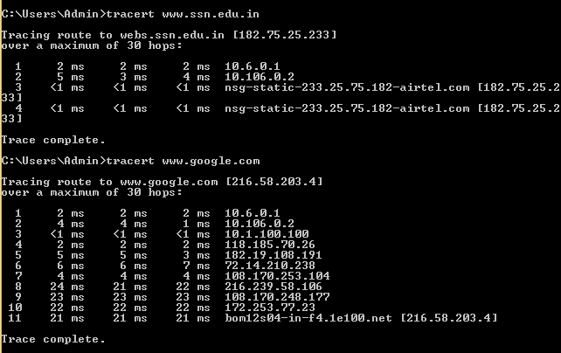

Slide 36
ICMP Checksum
In ICMP the checksum is calculated over the entire message (header and data).

Slide 37
Example
Figure shows an example of checksum calculation for a simple echo-request message. We randomly chose the identifier to be 1 and the sequence number to be 9. The message is divided into 16-bit (2-byte) words. The words are added and the sum is complemented. Now the sender can put this value in the checksum field.

Slide 38
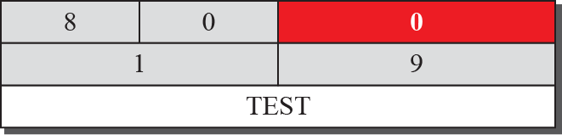
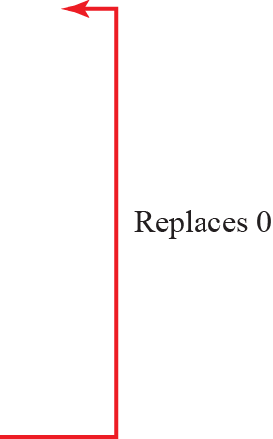
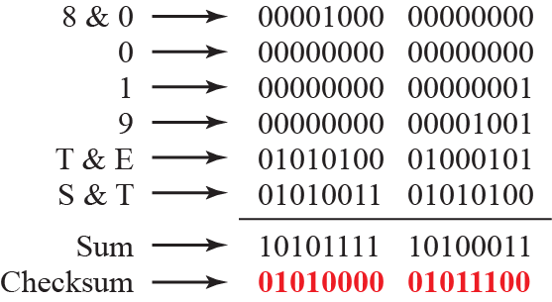
Figure 19.11: Example of checksum calculation

Slide 39
Check Your Understanding
A packet has arrived in which the offset value is 200, the value of HLEN is 5, and the value of the total length field is 100. What are the numbers of the first byte and the last byte?

Slide 40
Outcome
Student should be able to understand
Internet protocol
Fragmentation Concept
ICMP

Slide 41
THANK YOU

